Slide 1
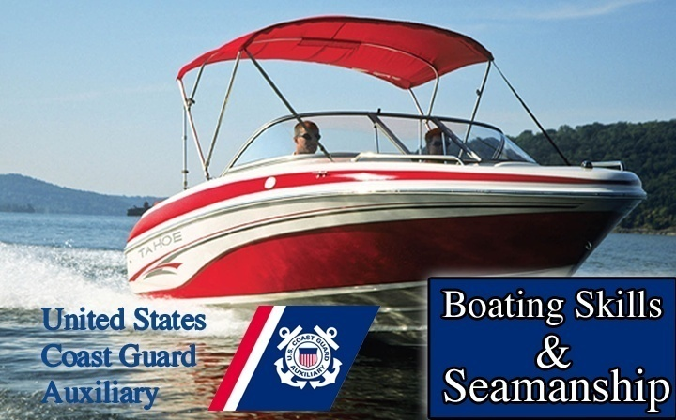
Your Boat’s Radio
Chapter
13

Slide 2
Test
One
Two
three

Slide 3
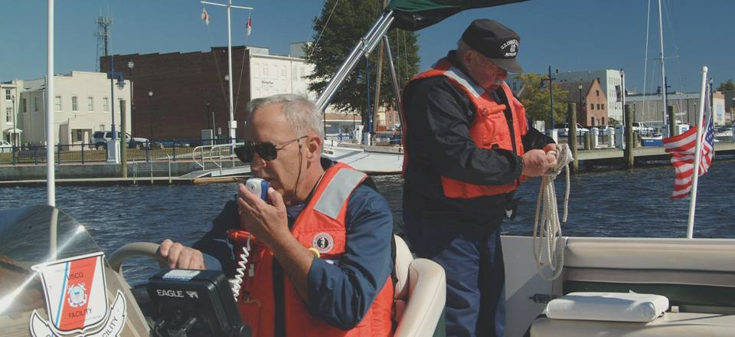
Your Boat’s Radio
Chapter
13

Slide 4
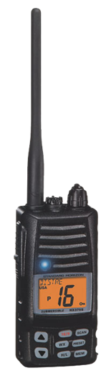
Lesson Objectives
Types of Radios
Functions and use of radios
Necessity of station license
Radio operator’s license
Buying a radio
Radio limits
Antenna selection
Radio check
Distress calls

Slide 5
Radio Functions
The three functions of the VHF and SSB marine radios are:
  Safety messages
  Operational messages
  Commercial messages
No other type of message is permitted

Slide 6
FCC License
A FCC Station License is required If –
  Vessel is Over 65 feet in Length
  Visiting Foreign Ports
  Making International Calls

Slide 7
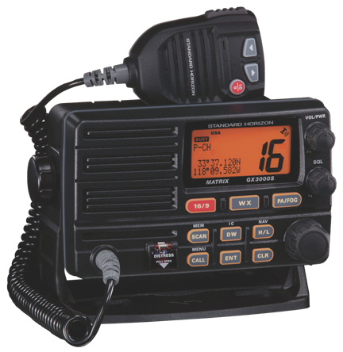
Communications on the Water
Coastal and Inland Communications
  SSB radios (Coastal)
  VHF Marine radios (Inland) (Great Lakes)
  Citizen Band radios
  Amateur radios
  Cellular telephones

Slide 8
VHF-FM Radios
FM - Static Free
Line Of Sight – 10 - 15 Miles
Used & Monitored By U.S. Coast Guard
25 Watts Maximum Power
Relatively Inexpensive
Used in the Great Lakes

Slide 9
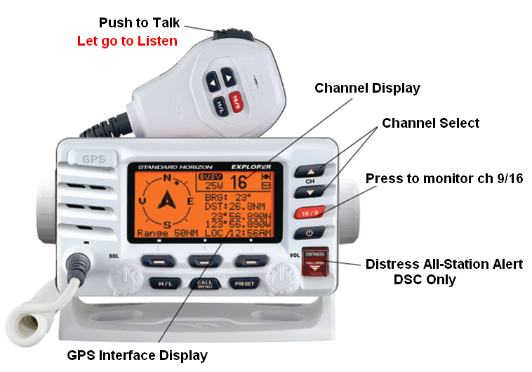
DSC VHF – FM Radio

Slide 10
DSC MMSI
VHF-FM with DSC should be registered
Marine Mobile Service Identity
  Auto Identify your radio when transmitting
  Registered Through FCC (charge)
  BoatU.S. Sea Tow Services International (Free)
  Uses Channel 70

Slide 11
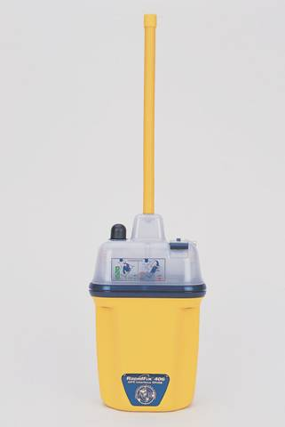
Coastal Communications
Coastal or Offshore
  SSB-AM Single-sideband radios
  Amateur radios
  Emergency Position-Indicating Radio Beacons
  Satellite Cell Phones
Reprinted with permission from Rough Weather Seamanship for Sail and Power by Roger Marshall

Slide 12
Citizen Band (CB) Radio
Low power - 5 watts
Limited Range
Not Monitored By Coast Guard
Overcrowded
AM - Susceptible To Static
Channel 9 - Unofficial Emergency Frequency
Inexpensive

Slide 13
Other Systems
Licensed Amateur Radio Operators (HAM)
  Several Short Wave Frequencies Available
Cellular Telephones
  Not Monitored By Others
  Coast Guard cannot locate with RDF as a Marine Radio
  Call Coast Guard or 911
  Limited reception on water

Slide 14
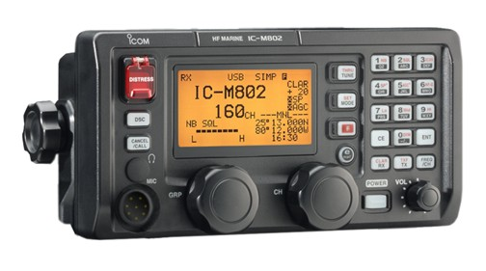
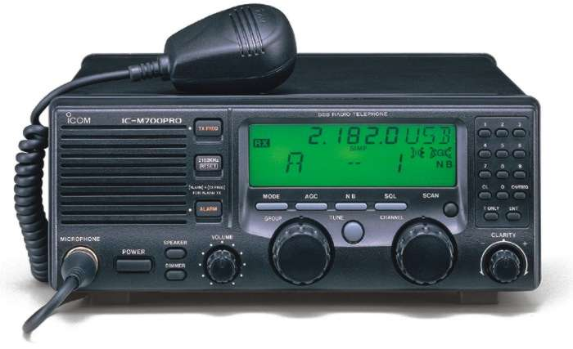
Single Sideband Radio
Range – 25 mi to worldwide
Monitor Weather
Access to public telephones
Monitored by USCG (limited)
Reprinted with permission from Rough Weather Seamanship for Sail and Power by Roger Marshall

Slide 15
SSB Radios
Range
  Day - 100 miles
  Night - 1000 miles
Recommended for Ocean Operation
Monitored By U.S. Coast Guard
More Costly Than VHF-FM
Must Also Have VHF-FM Radio

Slide 16
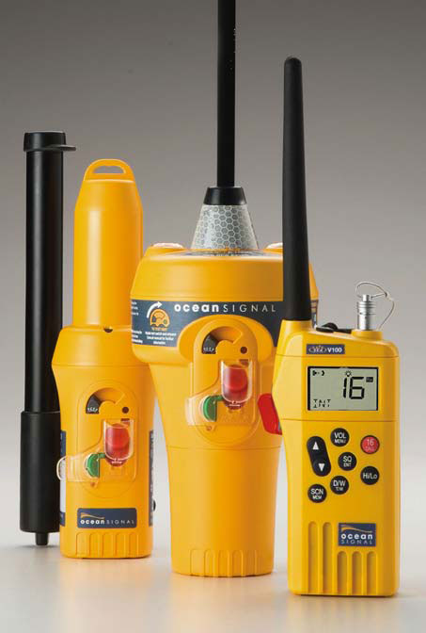
EPIRB
Transmits emergency calls via satellite
Small- portable
Transmits boat’s identity and location
Range worldwide
One way communication
Monitored by USCG

Slide 17
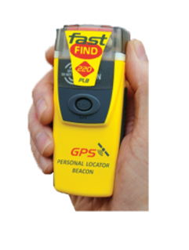
Personal Locator Beacon (PLB)
Personal version of EPIRB
Registered to an individual
Range worldwide
Monitored by USCG

Slide 18
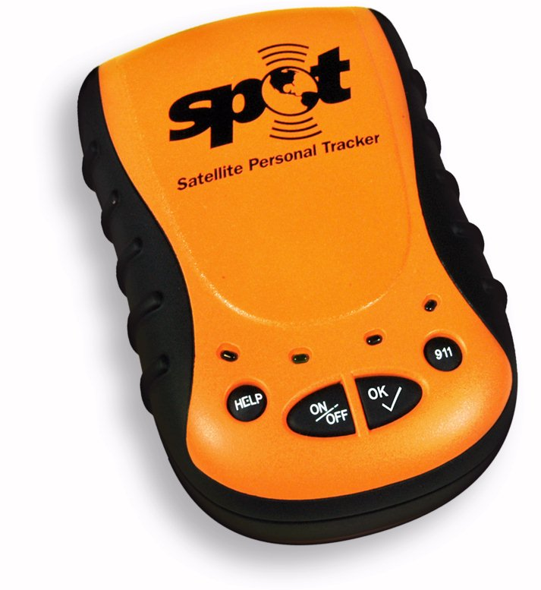
Satellite Personal Messenger (SPOT)
Tracked by Globalstar
Information forwarded to sub-agencies
Tracks actual wearers movements
Signal strength not as strong as EPIRB system

Slide 19
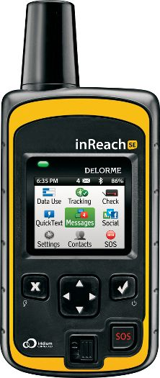
In Reach
Uses Iridium Satellite Network
Communication via dedicated transceivers, Apple and Android devices
Tracks movement of caller

Slide 20
Automatic Packet Reporting Sys. (APRS)
General VHF communication system
Not specifically for emergencies
Messages repeated limited times
No assurance responders will be notified

Slide 21
Student Activities
Who recalls the three functions of the VHF and SSB marine radios?
They are….
  Safety messages
  Operational messages
  Commercial messages

Slide 22
Licenses
Station license
  Required when using ships SSB radio
  Issued by the FCC
Operator permit
  Restricted radiotelephone operators permit is required when in foreign waters

Slide 23
Selecting Your VHF-FM Radio
Advantages of the Global Maritime Distress and Safety System
  Uses Ch. 70 for distress calls
  MMSI (Maritime Mobile System Identity) provides vital boat info.
  Can be interfaced with GPS for position info.
  Operator is free to handle emergency while distress is being sent!
  Ship to Ship automated calling

Slide 24
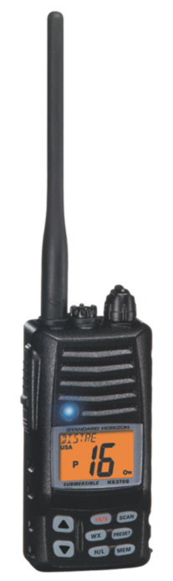
Selecting Your VHF-FM Radio
Sensitivity
  ability to receive weak signals
Selectivity
  rejecting signals from adjacent channels
Audio output
  radio loudness (boats are noisy)
Signal strength
  1watt, 5watt, 25watt
  Signal suppression
    one radio stepping on another
Squelch
  Stops noise when not receiving
  Too much squelch suppresses weak signals

Slide 25
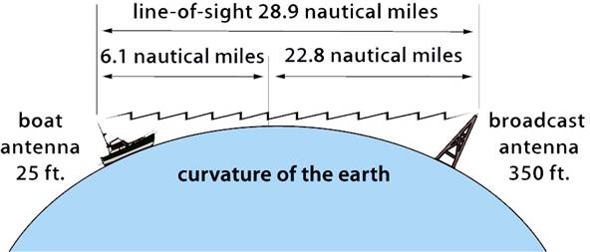
Selecting Your VHF-FM Radio
Line of sight transmission
Available channels
Channel selector

Slide 26
Antennas
Height
  Line-of-Sight
  Higher Is Better
Gain
  3 db, 6 db, 9 db
  6 db Practical
3 db
6 db
9 db

Slide 27
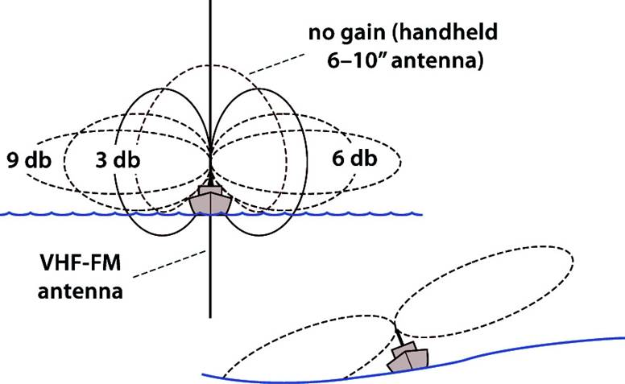
Installation

Slide 28
Installation
Do not try to repair
Do not mount near compass
Positive power lead RED + goes to radio
Install correct type of antenna
Place antenna at highest point of boat
Allow room to lower antenna as needed

Slide 29
Operating Your VHF-FM Radio
Important caveats:
No false distress calls
No obscenity
Not used inland
Shift from calling to working channel
Speak slowly and distinctly

Slide 30
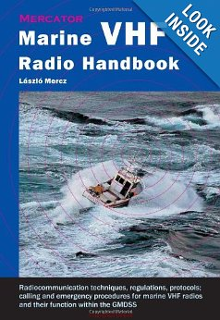
Copies of the Rules
Where to obtain
  Superintendent of documents
  http://bookstore.gpo.gov
  Internet (amazon)
Rules violations
  FCC investigates
  Loss of license
  Fines and imprisonment

Slide 31
Calling Another Station
Choose the correct channel when calling
Limit the hailing call to 30 seconds
If there is no answer, wait 1 minute before hailing again
After three attempts wait 15 minutes
Limit ship to ship calls to 3 minutes but move to another working channel first
Limit ship to ship calls to ship’s business
Radio checks are prohibited on Channel 16.
Use Channel 9 for radio checks
Use low power (1 watt) whenever possible

Slide 32
Calling Another Station
Remember to ….
Check power
Listen
Press microphone button
Normal tone
Pro-words to use
You can’t hear reply until you let the microphone button go…..

Slide 33
Calling Limited Coast Station
Hail Limited Coast Stations on their working Channel first
i.e. bridge operator channel 13 or 9
Listen
If that doesn’t work try local calling channel i.e. 16

Slide 34
Selecting Your VHF-FM Radio
Radio watch
  Radios need not be operating while boating.
  If you do have radio on, then it should be kept on Ch. 16 when not being used on another channel.
Radio station log
  Not required for Vessels 65 feet and smaller.
  However all emergency calls you hear must be recorded as completely as possible

Slide 35
Special Purpose Channels
CH 16 - Distress, Urgency, Safety
CH 9 - Alternate Calling Channel
CH 12 - Port Operations
CH 13 - Navigation
CH 22A - Coast Guard Liaison
CH 68 - Non-Commercial Working
WX-1, WX-2, WX-3
Note: “A” designation means USA

Slide 36
Student Activity
What is Ch.16 used for?
Distress
Urgency
Safety
Hailing
1
2
3
Notes:
Instructor Notes:
Ask: why each of these is an important safety consideration?

Slide 37
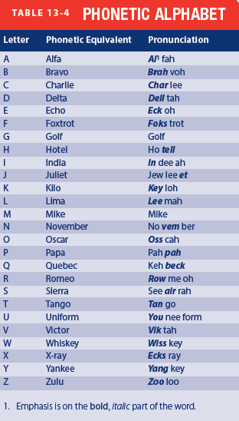
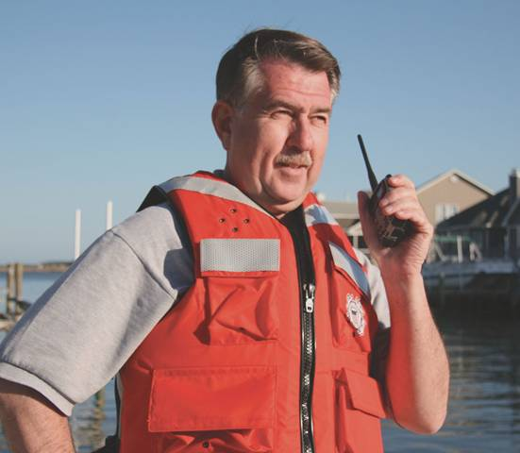
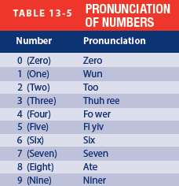
Phonetic Alphabet
Spelling
Numbers

Slide 38
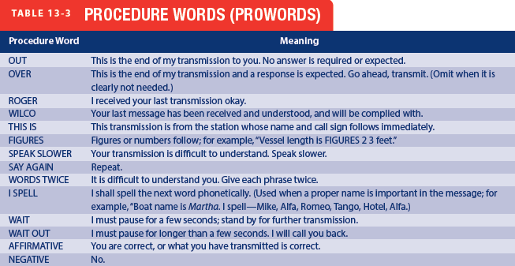
Phonetic Alphabet

Slide 39
Distress, Urgency, and Safety Calls
Distress signal: Mayday
  French venez m'aider - Come Help Me
Urgency signal: Pan-Pan
  French panne – Mechanical Breakdown
Safety signal: Secur-i-tay
  French Sécurité

Slide 40
test
One
Two
Three

Slide 41
Distress Signal
Use When IMMINENT Danger Exists
Call On Channel 16 or Cell Phone 911
Call Format:
  “Mayday Mayday Mayday”
  “This Is (Name Of Your Boat)”
  Give Location Lat/Long or Visual
  Problem
  Number of persons onboard
  “This Is (Name Of Your Boat), Over”
  Follow the Coast Guards Direction

Slide 42
Calling Time Limits
1st Call - 30 Seconds Maximum
  Then - Wait 2 Minutes
2nd Call - 30 Seconds Maximum
  Then - Wait 2 Minutes
3rd Call - 30 Seconds Maximum
  Then - Wait 15 Minutes Before Additional Calls To The Same Station

Slide 43
Crew Training
Crewmembers to be familiar with how to operate the VHF-FM Marine radio
Everyone on board including children should be able to operate a radio to call for help in an emergency
Before leaving port explain how to operate your boats radio to all onboard

Slide 44
Automated Identification System (AIS)
Warning system required for 3000+Ton boats
Broadcasts 84 different messages
Less elaborate receivers optional on smaller boats
AIS enabled GPS displays AIS boats

Slide 45
During Distress Communications
Stop All Other Communications when you hear:
  “All Stations”
  “SEELONCE Mayday”
  “SEELONCE Distress”
When Distress Is Over
  “SEELONCE FEENEE

Slide 46
During Distress Communications
Willful violation of radio regulations carries severe penalties
Revocation of License
Fines
Imprisonment

Slide 47
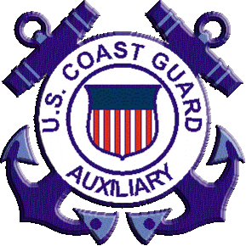
Thank you
Illustrations provided by McGraw Hill Education
The

